Slide 1


DATABASE MANAGEMENT SYSTEM PROJECT
Tailoring and Boutique Order Management System
Python Tkinter · mysql.connector · MySQL
Aarya Dubey (25WU0101003)
D. Neshitha (25WU0101028)
01 / 10

Slide 2
Problem & objectives
DBMS PROJECT
Problem & objectives
Manual boutique records do not scale across customers, measurements, fabrics, orders, tailors, trials, alterations, invoices, and payments.
Centralize data | Manage catalogues
Customer and measurement data | Garments, designs, fabrics, and stock
Track orders | Assign tailors
Orders, delivery, and fitting trials | Assignments, trials, and alterations
Protect integrity | Support reports
Inventory and payment integrity | Delivery, workload, and revenue
02 / 10

Slide 3
Scope: one workflow, one system
Boutique operations
Technology stack
Customer and measurement profiles
Garment, design, and fabric catalogues
Order booking and delivery tracking
Tailor assignments and fitting trials
Alterations, invoicing, and payments
Python Tkinter · ttk
mysql.connector · MySQL 8.0
SQL views and triggers
TECHNOLOGY STACK
Python Tkinter
mysql.connector
MySQL 8.0
03 / 10

Slide 4
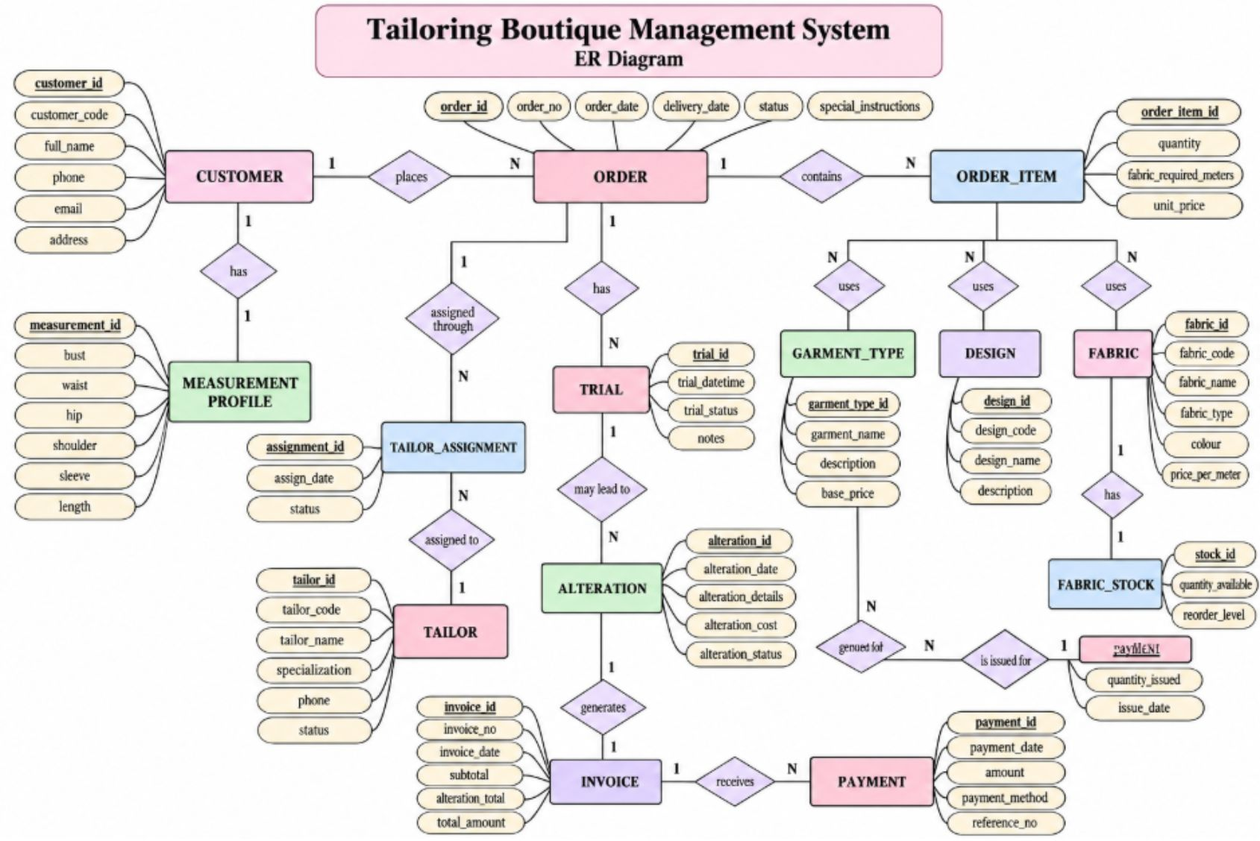
ER Diagram
DBMS PROJECT
Data model
ENTITIES
WORKFLOW LINKS
Customer, Measurement Profile, Garment Type, Design, Fabric, Stock, Order, Order Item, Fabric Issue, Tailor, Assignment, Trial, Alteration, Invoice, Payment
Customer → Orders; Order → Items and Invoice; Tailor → Assignments; Order → Trials and Alterations; Invoice → Payments
04 / 10

Slide 5
Relational schema, normalized to 3NF
DBMS
CUSTOMERS(customer_id, customer_code, full_name, phone, email) | ORDERS(order_id, order_no, customer_id, order_date, delivery_date, status)
ORDER_ITEMS(order_item_id, order_id, garment_type_id, design_id, fabric_id, quantity, unit_price) | TAILORS(tailor_id, tailor_code, tailor_name, specialization, status)
INVOICES(invoice_id, invoice_no, order_id, subtotal, alteration_total, total_amount)
TAILORS(tailor_id, tailor_code, tailor_name, specialization, status) | INVOICES(invoice_id, invoice_no, order_id, subtotal, alteration_total, total_amount)
Schema
1NF atomic values, no repeating groups
2NF order- and item-level facts separated
3NF customer, garment, fabric, and tailor details separated
05 / 10

Slide 6
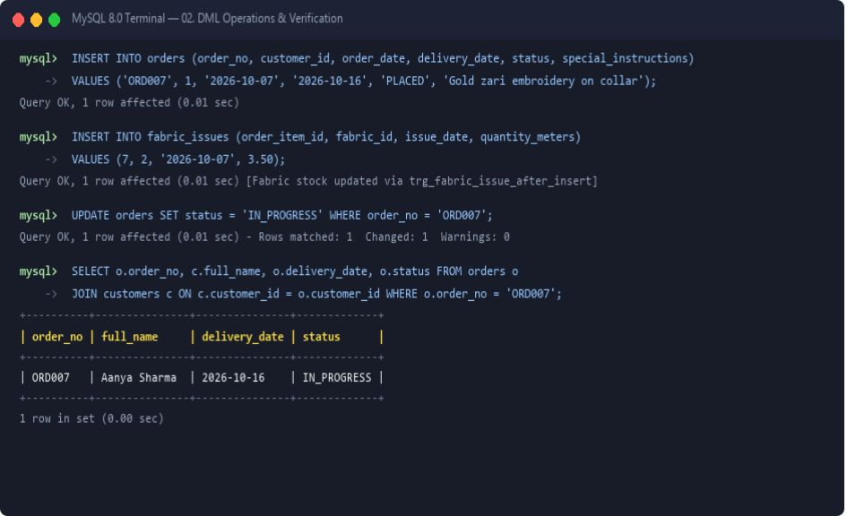
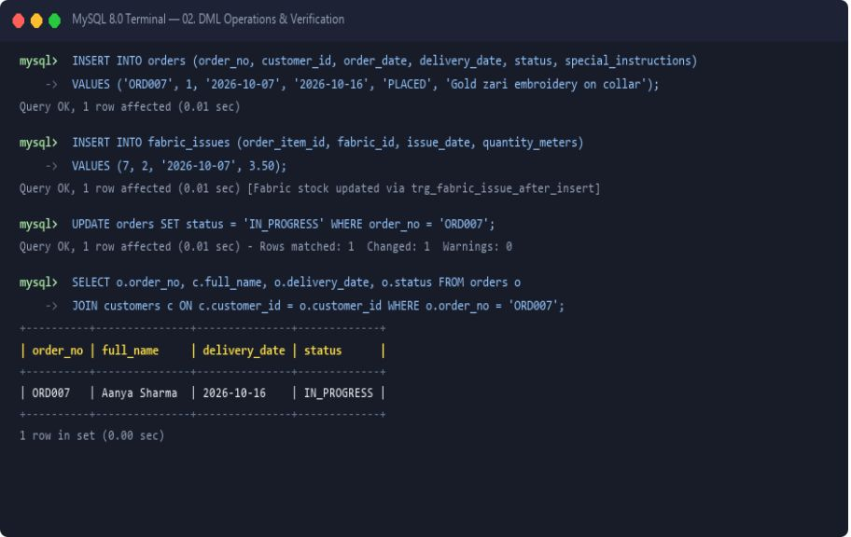
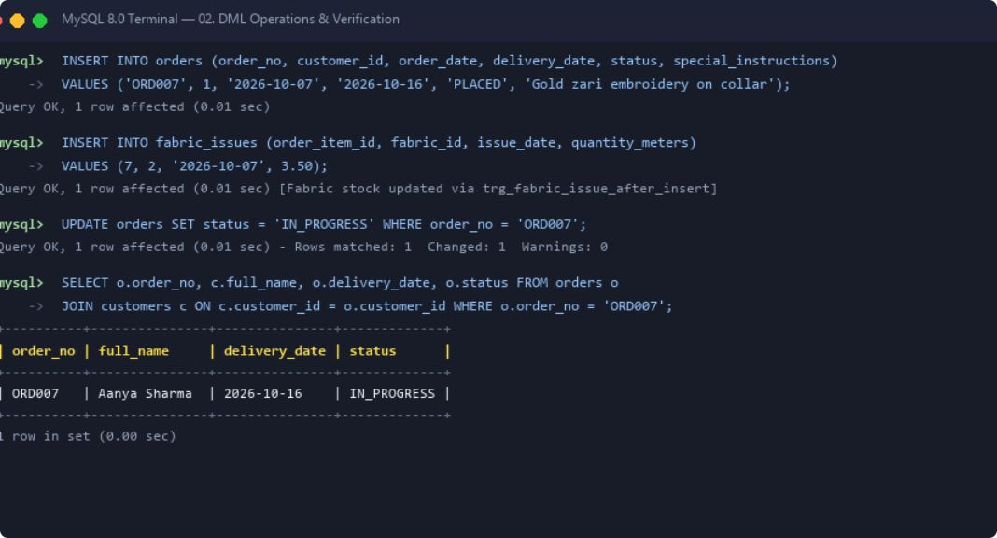
Database built and managed in MySQL
DBMS PROJECT
MySQL
CREATE DATABASE tailoring_boutique;
CREATE TABLE customers (...);
Primary Key · Foreign Key · UNIQUE · NOT NULL · CHECK
Triggers prevent fabric issues beyond stock and payments beyond invoice balance.
At least 5 records are inserted into each table.
06 / 10

Slide 7
SQL queries and outputs
DBMS
JOIN · customers + orders + invoices
Aggregate
Queries
SELECT c.full_name, o.order_no, o.status, i.total_amount ...
SELECT tailor_id, COUNT(*) AS assigned_orders ... GROUP BY tailor_id
Output: customer, order status, invoice total
Output: assigned-order counts by tailor
Subquery
View report
WHERE total_amount = (SELECT MAX(total_amount) FROM invoices)
SELECT * FROM v_delivery_due;
Output: invoice with maximum total
Output: delivery-due report
07 / 10

Slide 8
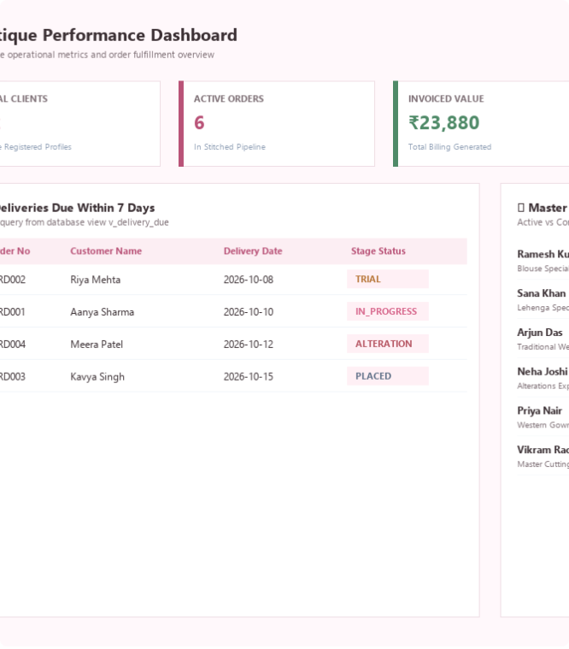
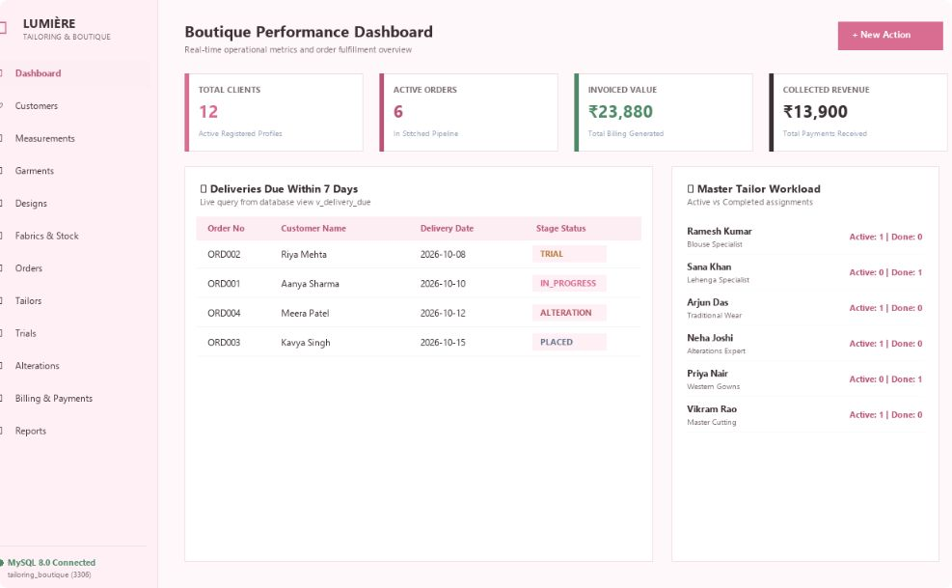
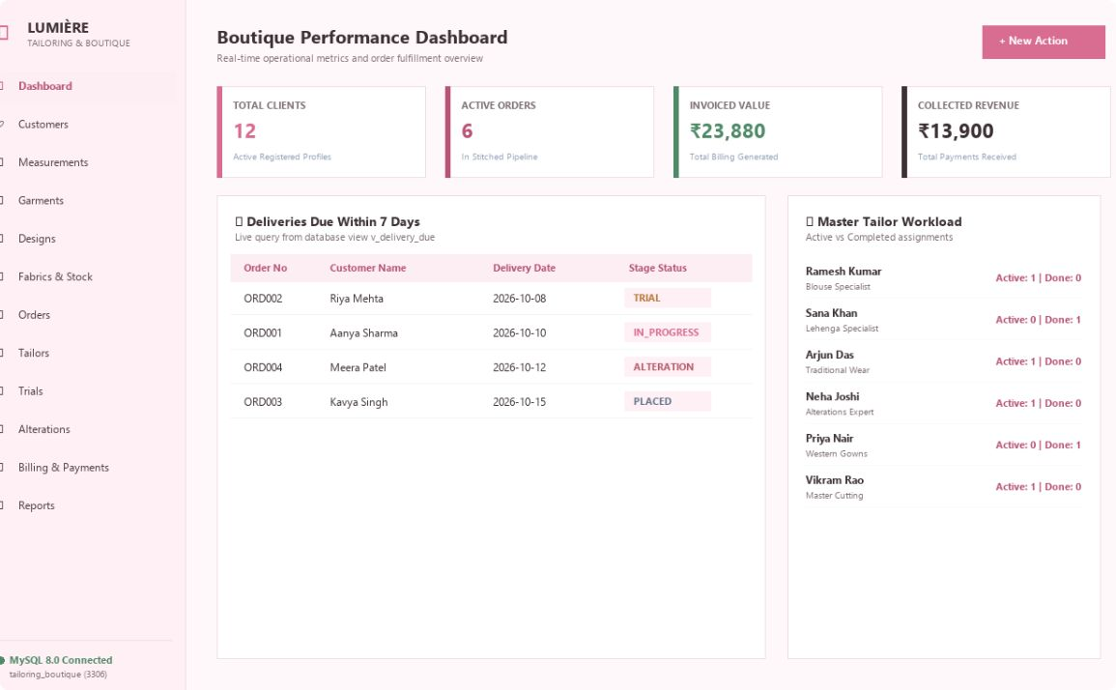

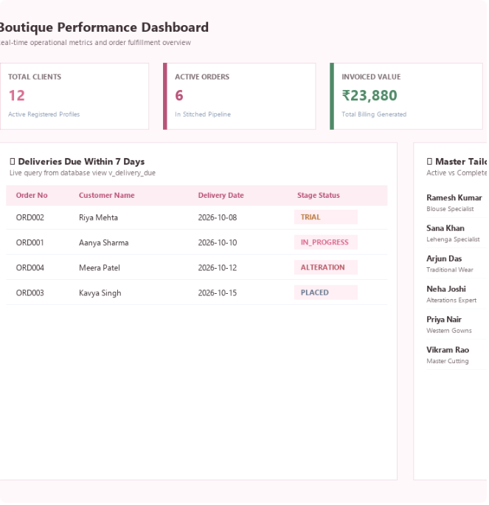
Working system: boutique interface
DBMS PROJECT
Interface
08 / 10

Slide 9
From customer record to payment
DBMS PROJECT
01
02
03
04
Workflow
Customer profile
Order booking
Tailor assignment
Trial & alteration
Customer and measurements
Garment, design, fabric
Fitting and changes
Fabric issue
05
06
07
07
Invoice & payment
Delivery & reporting
Billing and collection
Delivery reports
Order workflow screenshot
09 / 10

Slide 10
DBMS PROJECT · CONCLUSION
Conclusion
Lumière Boutique centralizes the tailoring lifecycle in a normalized MySQL database connected to a Python desktop interface.
It improves traceability across measurements, stock, orders, trials, alterations, billing, and payments.
FUTURE
Web/mobile access
WhatsApp notifications
Barcode tagging
Predictive inventory
POS integration
Thank you. Questions?
10 / 10

